Slide 1

SeaAlert
Classifying Maritime Distress Messages with LLM- Generated Data
Presenter:
Tomer Atia, Ilana Estrin

Slide 2

Project Review-SeaAlert - Interim
Goal: Classify maritime VHF messages into 4 severity levels (Routine, Safety, Urgency, Distress)
Input & Output
What changed from the proposal
Novelty / contributions
Evaluate on a hard subset: actual_codeword = NONE
Evaluate with masking: replace codewords with [CODEWORD]
input: message text (synthetic VHF-style transcript)
Output: 4-class severity label
Built a balanced synthetic dataset (300 samples, 75 per class) with realistic metadata (style, scenario, etc.)
Showed that codewords and style can act as shortcuts and measured the drop under masking
Compared a classical baseline
(TF-IDF+LR) vs a transformer baseline (DistilBERT) under the same robust settings

Slide 3

Related Work (Previous Work)
Title | Year | Task | Data & modality | Method | Key results | Relation to SeaAlert
AI-based approach for transcribing and classifying unstructured emergency call data: A methodological proposal. [reference] | 2023 | ASR + classify emergency calls | 2019 “1-9-2” calls (SAMU Brazil) | Speech-to-text + text classification pipeline | Works despite noisy audio | Same pipeline idea: comms -> transcript -> severity
Adaptation and Optimization of ASR for the Maritime Domain in VHF Communication. [reference] | 2025 | Improve VHF ASR (noise, accents, jargon) | ~62h VHF (EN+DE), ~6h real test | Fine-tune XLSR; compare to Whisper (WER) | Lower WER after adaptation | Better transcripts improve downstream severity model
Synthetic Data Generation with Large Language Models for Text Classification: Potential and Limitations. [reference] | 2023 | When synthetic text helps classifiers | Multi-setting synthetic-text studies | LLM generates labeled text; train classifiers | Helps sometimes, sensitive to ambiguity/eval | Supports our approach + warns to use robust eval (NONE-only, masking)

Slide 4

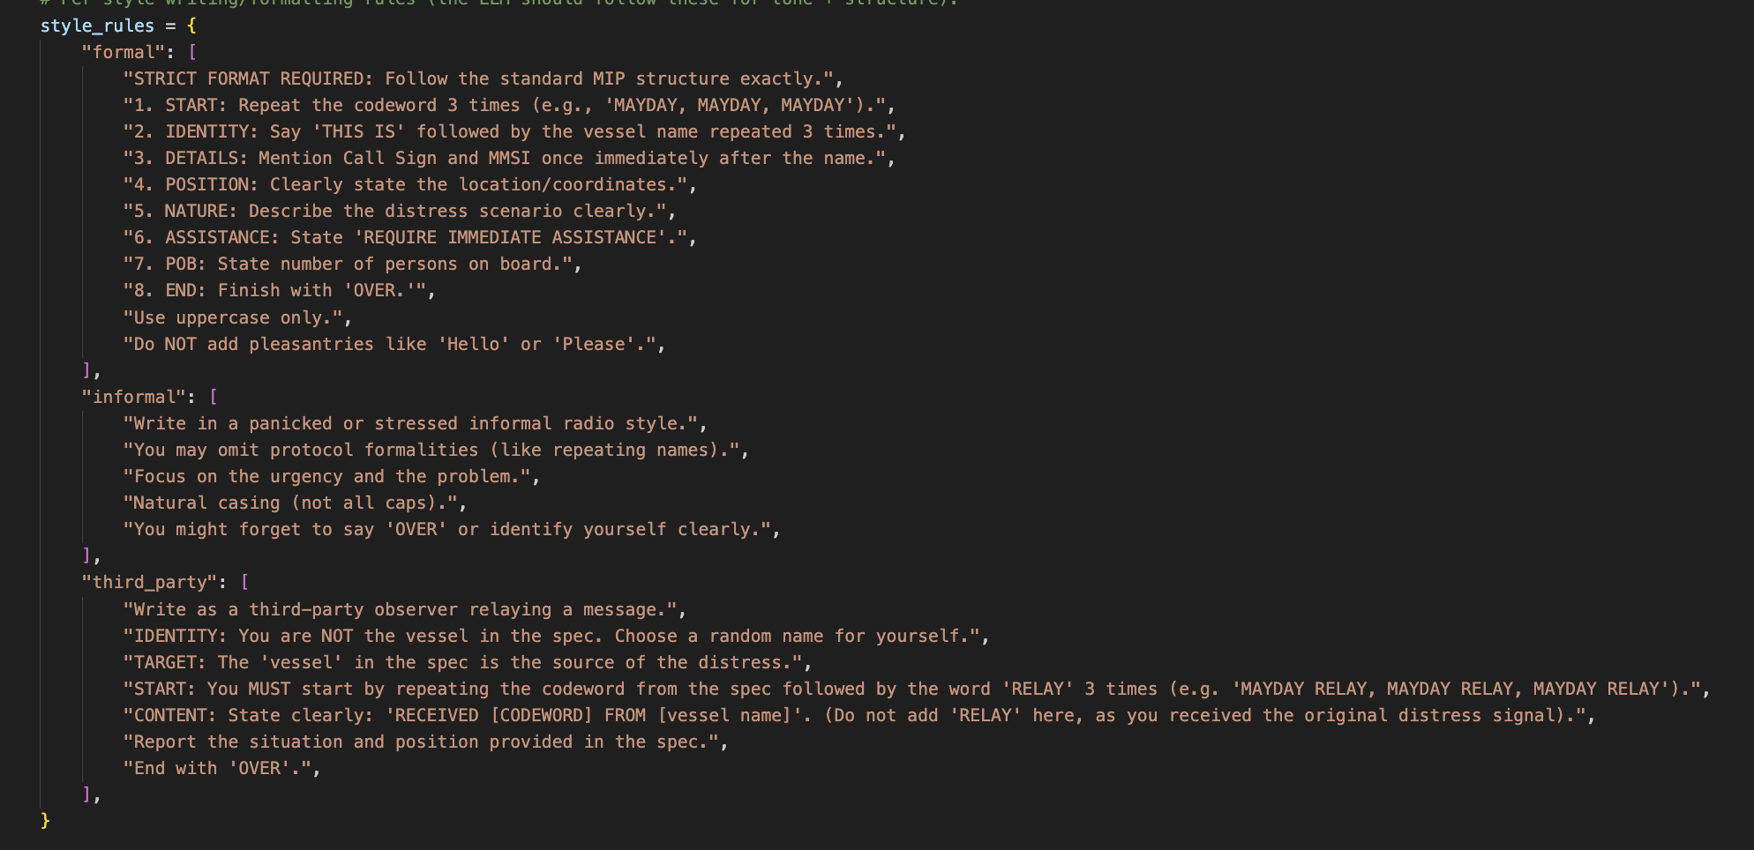
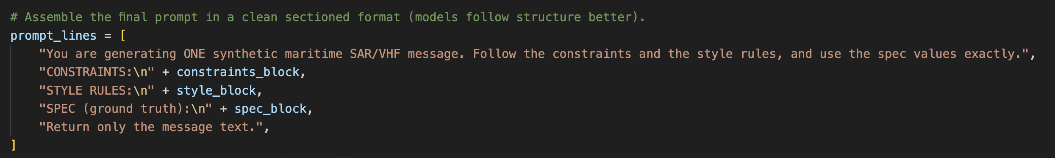
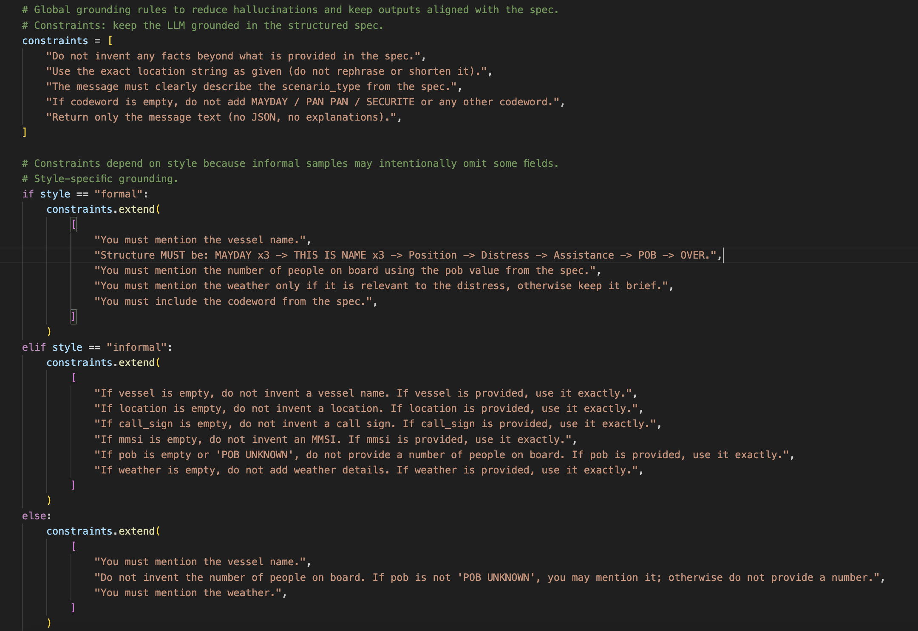
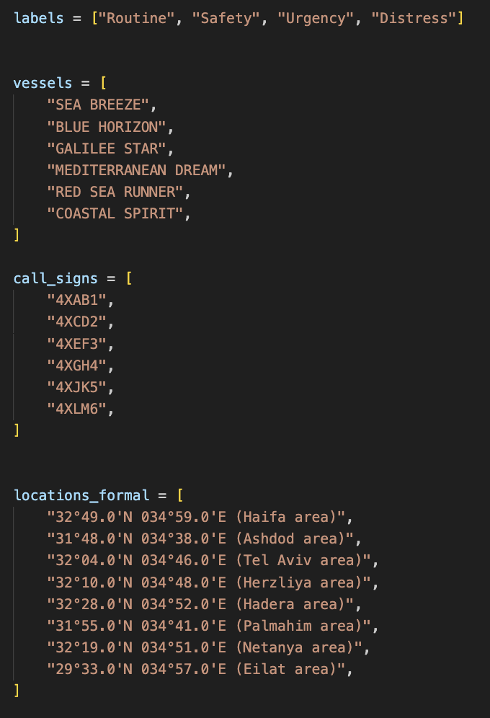
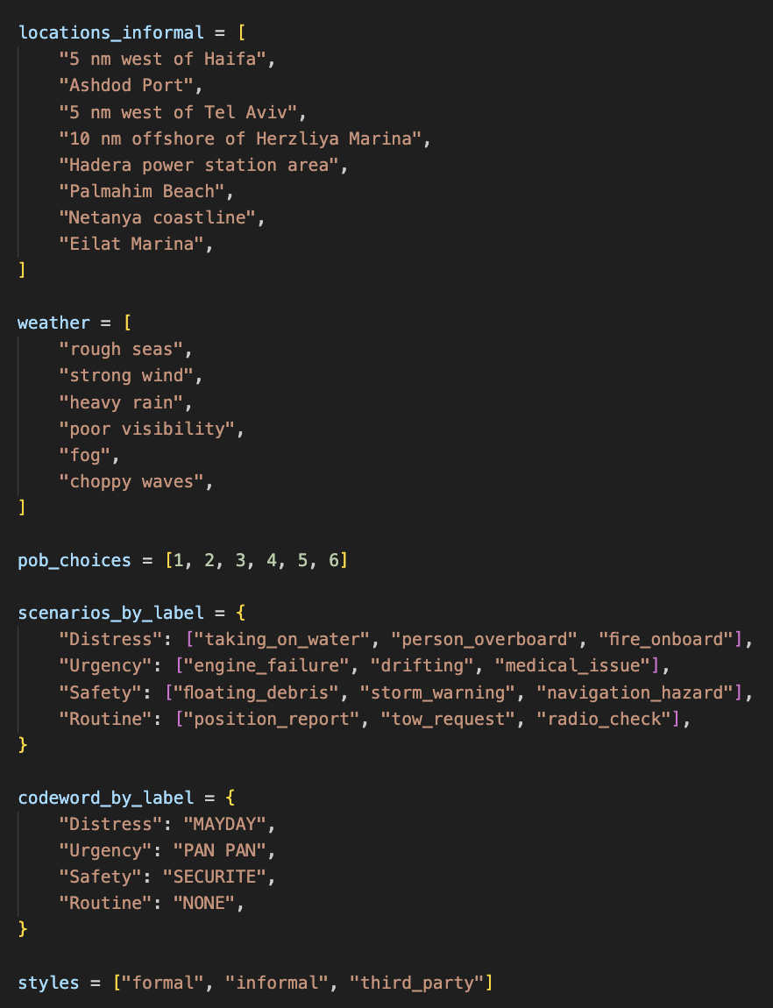
Data Generation - Prompt Design

Slide 5
Examples:
Label | Informal (No Codeword) | Third Party | Formal
Distress | "Red Sea Runner,we’re taking on water, it’s coming in fast and we can’t keep up. Visibility’s terrible in this fog. Need immediate assistance, anyone nearby respond." | "MAYDAY RELAY, MAYDAY RELAY, MAYDAY RELAY. I’m a nearby boat, I just picked up a MAYDAY from SEA BREEZE, call sign 4XCD2. They report a person overboard off Palmahim Beach and the visibility is really poor - they’re struggling to keep sight of them. Any vessel in the area assist immediately. OVER | "MAYDAY, MAYDAY, MAYDAY THIS IS GALILEE STAR, GALILEE STAR, GALILEE STAR CALL SIGN 4XJK5 MMSI 520511037 POSITION 32°28.0'N 034°52.0'E (HADERA AREA) FIRE ON BOARD, STRONG WIND REQUIRE IMMEDIATE ASSISTANCE 3 PERSONS ON BOARD OVER."

Slide 6
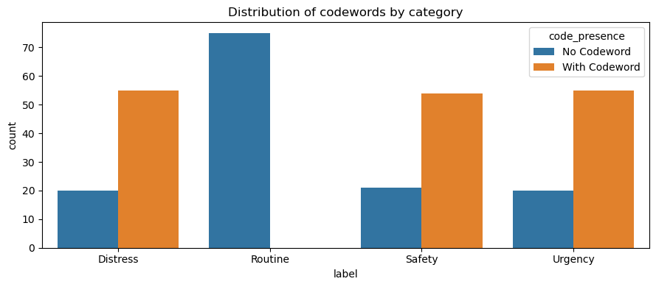
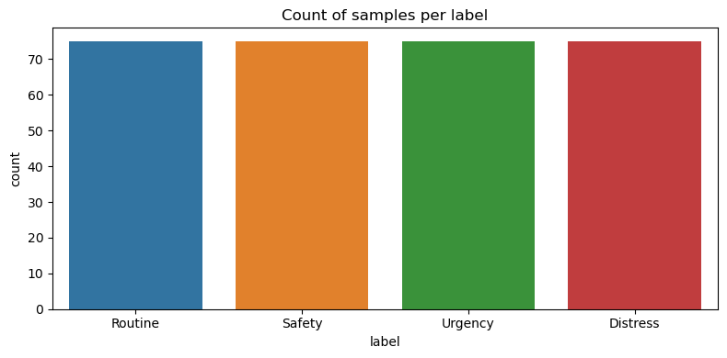
Dataset + EDA (300 samples)
Dataset (what we created)
Data generation + labeling
Synthetic VHF/SAR message dataset: 300 samples
4 severity labels: Routine, Safety, Urgency, Distress
Balanced: 75 per class
Fields: text, label, scenario_type, style, vessel, location, weather, POB, codeword
Messages were LLM-generated with controlled scenario + metadata (style, vessel, location, weather, POB)
Labels assigned by scenario severity (4-class target)
Codewords may appear (MAYDAY / PAN PAN / SECURITE) to reflect real radio protocol
Added codeword extraction + masking to support robustness tests in Stage 2
EDA highlights
Clean core fields: 0 missing in text+label, no duplicates
Balanced classes: 75 per class
Shortcut signals: codewords present in ~55% + style-label correlation
Takeaway: evaluate on NONE-only + masked input to test true context understanding

Slide 7

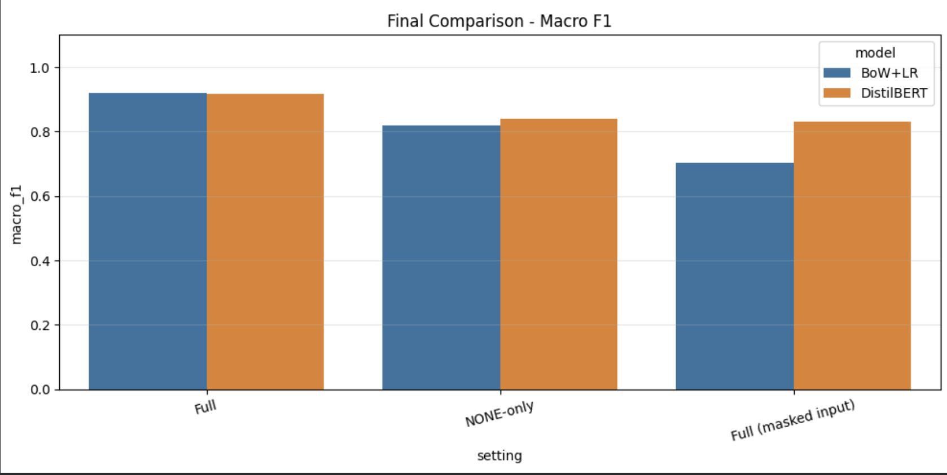
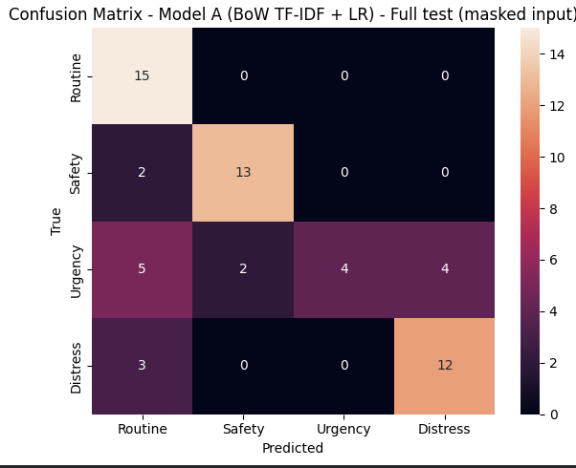
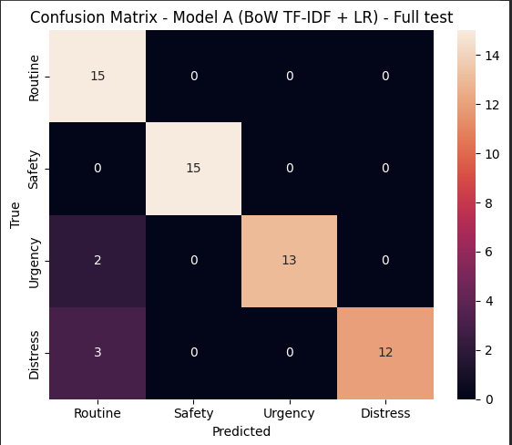
Baseline Solution and Results
Baselines
Results
Evaluation setup
Model A (classical): TF-IDF + Logistic Regression
Model B (pretrained): DistilBERT fine-tuning, 4-class head
Key finding: Masking causes a large drop (especially BoW+LR) → indicates shortcut reliance on codewords.
DistilBERT is more robust under masking and performs best on NONE-only.
Full test: standard split (60 samples)
NONE-only: test samples with actual_codeword = NONE (31 samples)
Masked input: replace MAYDAY / PAN PAN / SECURITE with [CODEWORD]
BoW+LR Confusion Matrices (Full vs Masked):

Slide 8

Plan (Roadmap to Final Project)
Step | Scope (what) | Technical (how) | Due date | Expected outcome
1 | Expand dataset to 1,000-1,500 samples | Generate new scenarios, keep balanced classes, keep metadata (style, vessel, weather, location, POB) | Week 1 | Larger, more diverse dataset, fewer artifacts
2 | Improve dataset quality | Add hard cases (implicit distress), add borderline examples, reduce “template” patterns | Week 1 | Better realism, harder evaluation
3 | Stronger baselines | Fine-tune RoBERTa-base and/or DeBERTa-v3-base for 4-class classification | Week 2 | Higher Macro-F1, better generalization
4 | Robustness evaluation | Re-run Full / NONE-only / Masked | Week 2 | Proof model learns context
5 | Error analysis | Inspect confusion pairs + analyze failures (esp. Urgency vs Distress), sample-level review | Week 2 | Clear explanation of weaknesses + next fixes
6 | Optional: LLM baseline | Add LLM zero-shot (prompted classification) as reference baseline | Week 3 | Compare classical vs transformer vs LLM
7 | Package + final deliverables | Clean notebook, tables/graphs, conclusions, limitations | Week 3 | Ready report + reproducible results
8 | Prepare final presentation | Final slides, final figures, key takeaways + demo examples | Final week | Final presentation ready

